Slide 1
The unfolding story of collins
MY PATH THROUGH IT.
COLLINS JOSEPH MUNYAO MWAURA
C025-01-0638/202

Slide 2
INTRODUCTION
My journey into the heart of this ever-changing realm began not with a monumental event but with a series of whispers, small moments of wonder, and challenges that carved the path I walk today. I am Collins, a 22-year-old Information Technology (IT) student on the cusp of completing my final year of study.
As you embark on this narrative with me, expect more than just a chronological account of a student’s life. Anticipate a story of transformation: how technology can be both a puzzle and a solution, how challenges can lead to growth, and how a young enthusiast can evolve into an aspiring professional poised to contribute to the vast, dynamic field of IT.

Slide 3
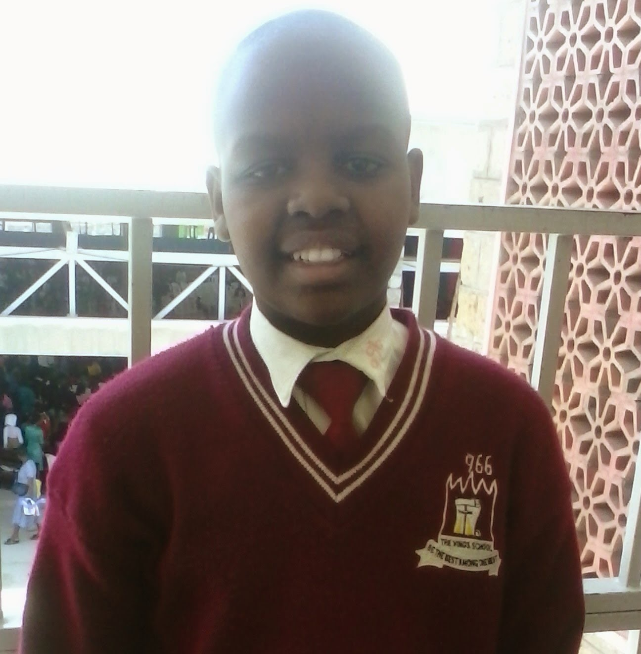
Early years
Born into a bustling household of five on the 5th of September 2001, I entered the world leading the pack. My parents, both seasoned businesspeople, crafted a home environment rich in love, ambition, and the subtle hum of entrepreneurial spirit.
Kings School Primary was more than just an educational institution; it was where my abstract interest in technology began to take a more defined shape. The school, known for its emphasis on holistic development, offered me my first taste of structured learning in computing. Suddenly, the gadgets and gizmos that I had only interacted with at home became subjects of academic inquiry. I was not just using technology; I was understanding it, learning about its potential to create, transform, and solve.

Slide 4
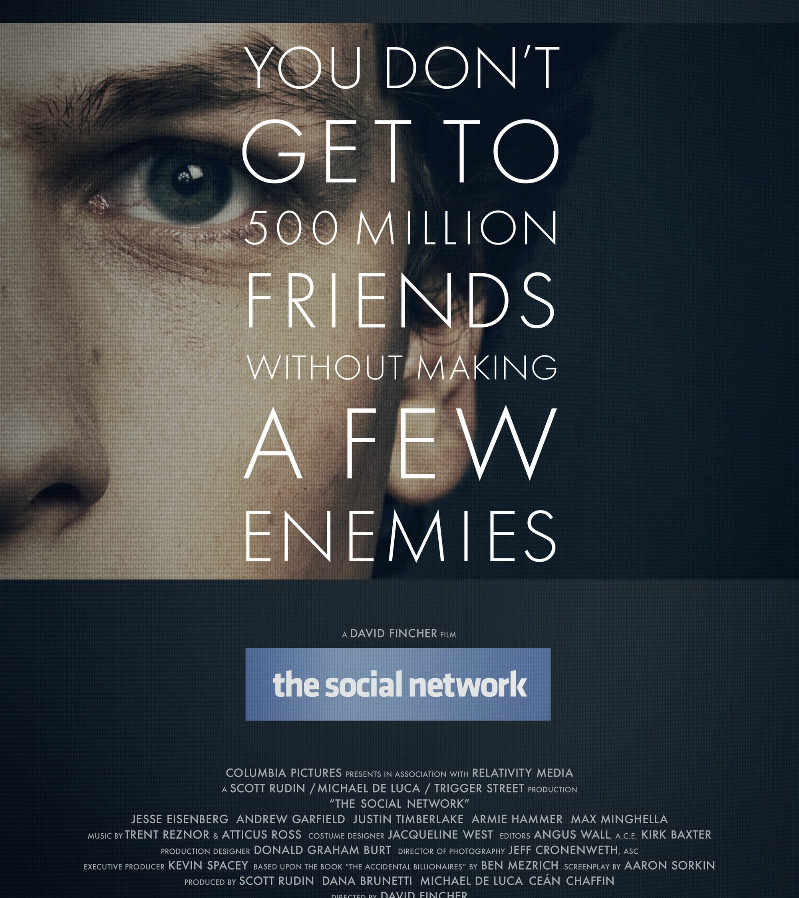
SPARKING THE FLAME
My fascination with technology was not confined to the tangible experiences of gaming consoles or computer lessons. It spilled over into the realm of fiction, where tech geniuses in movies became my heroes. These characters, with their ability to manipulate digital worlds and create wonders through coding, were more than just entertainment. They were a glimpse into what I aspired to become. Their feats on screen mirrored the possibilities I saw in technology—endless, exciting, and empowering.
My fascination with programming ignited not in the classroom, but in the dim glow of the cinema screen. Watching "The Social Network," I was captivated by the portrayal of Mark Zuckerberg's rise to prominence through Facebook. The idea that code could connect billions, influence global discourse, and create unparalleled opportunities for innovation struck a chord with me.

Slide 5
ACADEMIC PURSUITS
Despite my burgeoning passion for technology, the path was not without its detours. Upon completing high school, my mother envisioned a career in law for me—a profession respected for its stability and prestige. Law was my first choice, a nod to my family's expectations and a path well-trodden. However, fate had other plans. When the opportunity to study Information Technology at Dedan Kimathi University presented itself, the choice was clear.
University life offered an abundance of opportunities to dive deeper into the realms of technology that fascinated me. Courses on algorithms, database management, and software development provided the foundational knowledge I needed, but it was the hands-on projects and the collaborative environment that truly transformed my understanding of what it meant to be a part of the IT world. The collaborative projects, hackathons, and coding boot camps became arenas where I could test my skills, innovate, and learn from the successes and failures of my peers.

Slide 6
CHALLENGES AND TRUIMPHS
Losing Mark was like losing a part of myself; he had been a confidant, a motivator, and a source of joy in my life. His sudden departure left a void that seemed insurmountable, a pain that was both numbing and intense. The subsequent end of a three-year relationship with my girlfriend added another layer of emotional turmoil. These events were a stark reminder of the fragility of life and the complexities of human emotions. During this time, my academic and project commitments began to suffer. The allure of partying as an escape led to time wasted, projects delayed, and opportunities missed.
Recognizing the unsustainable path I was on, I sought therapy. Admitting the need for help was a humbling experience that marked the beginning of my journey towards healing and self-discovery. Therapy was transformative, offering not just a space to grieve and understand my emotions but also strategies to cope and rebuild. Gradually, the fog of depression began to lift, allowing me to regain clarity and refocus on my aspirations and responsibilities.

Slide 7
FUTURE ASPIRATIONS
Parallel to my entrepreneurial aspirations, I am drawn to the idea of pursuing a master's in data science, preferably abroad. This desire stems from a recognition of the power of data science in shaping the future of technology and its potential to address complex societal challenges. Studying abroad offers not just advanced education but a wealth of diverse experiences, exposure to global tech communities, and an opportunity to learn from the forefront of innovation.
Amid these ambitious professional goals, personal growth remains a cornerstone of my future. Fitness, which took a backseat during my tumultuous final years, will become a priority. The discipline and endurance fostered through regular physical activity are qualities that mirror the resilience needed in my professional journey.
Freelancing presents another avenue not just for financial independence but as a platform to hone my skills, expand my network, and work on diverse projects.

Slide 8
CONCLUSION
My journey thus far has been a tapestry of growth, discovery, and resilience—a journey marked by moments of triumph and trials, each shaping the contours of my aspirations and dreams. The path ahead, though strewn with uncertainties, glimmers with the promise of potential and the lure of untold adventures.
As I pivot from the role of a student to that of an innovator, entrepreneur, and lifelong learner, the mission remains constant: to harness the power of IT to bridge divides, to illuminate the darkened corners of society with the light of inclusivity, and to weave a tapestry of connectivity that unites disparate voices in a harmonious chorus.

Slide 9
CONT…
This is not the end but a new beginning, a chance to forge a legacy of innovation, to make a mark on the world through technology, and to build bridges that connect us all. In the symphony of life, my story is but a single note, yet I am resolved to make it resonate, to contribute to a harmony that transcends boundaries and to play my part in the grand narrative of human progress. The future beckons with open arms, and I am ready to embrace it, to turn dreams into reality, and to embark on a journey where the only limits are those of imagination.

Slide 10


